Slide 1

SearcherCentric Search
Distributed Search, but Fast
Notes:
Hey I’m Jackson Morgan.
Thanks to the Espresso team for inviting me out
I’m going to be talking about an alternative way to do global search: Searcher Centric Search

Slide 2
In one
SPARQL Query
I want to search all data in existence
To Which I Have Been
Granted Access
Notes:
Let’s start out with the big picture. I think that we can all agree that it would be pretty awesome if we had infrastructure that would allow me, the developer to “creae one SPARQL Query that will search ALL DATA IN EXISTENCE to which I have been granted access” It’s a big goal, but we can break it down into a few component goals.

Slide 3
“enable large-scale data search across Solid pods”
“respecting individuals’ data sovereignty, considering individuals’ different access rights and caching needs”
Keep the average query as fast as possible (under 5000 milliseconds)
Request count and duration remains constant as Pod quantity increases
Offload search compute from the data owner
Notes:
Espresso points out two goals:
First is “enable large-scale data search across Solid Pods” – Pretty good. This accomplishes our main goal because we can at least imagine a world where all data is in a Solid compatible interface.
Second is “respecting individuals’ data sovereignty, considering individuals’ different access rights and caching needs” - this is where things get interesting. It’s conceptually easy to make a centralized index that can query across datasets. But, it’s more difficult to design indexes that don’t expose data to parties that haven’t already been granted access to it
So these are the two goals Espresso lists, but the rest of this presentation is going to be my argument to design systems that accommodate three more goals. Namely:
Keep the average query as fast as possible (under 1000 milliseconds)
Query time WRT number of pods scales in constant time
Offload search compute from from the data owner
Let’s talk about these

Slide 4
Keep the average query as fast as possible (under 5000 milliseconds)
Notes:
Starting with “Keep the average query as fast as possible.” Why is speed important?

Slide 5




VS
Notes:
Well, I’m sure we want to succeed as the Solid community, but we’re competing against apps that can centralize their data because they don’t care about data ownership.

Slide 6
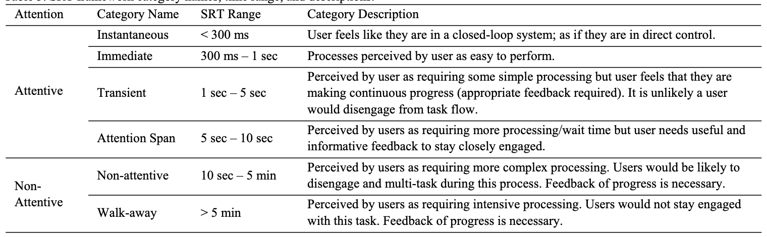
Source: https://www.sciencedirect.com/science/article/pii/S2351978915004370
Notes:
This is from a user study conducted by Intel on the effects of load times on user perception. As much as we’d like to think users care about privacy, if we’re operating down here while our competitors are operating up here, it’s going to be hard to get user adoption. At over ten seconds “users are likelyto disengage” and even at five seconds, users need significant informative feedback to not disengage

Slide 7
Index Data
Search Compute
Index Data
Search Compute
Index Data
Search Compute
Notes:
Any system we design is going to need to be a way to load data from the index into whatever entity is doing compute

Slide 8
Load from Local Memory
(250k ns)
Index Data
Search Compute
Load from Network in the Same Datacenter
(10M ns)
Index Data
Search Compute
Load from Network Cali – Netherlands
(150M ns)
Index Data
Search Compute
Source http://www.cs.cornell.edu/projects/ladis2009/talks/dean-keynote-ladis2009.pdf
Notes:
But we have a choice on how to load that index, and we should choose what’s fast. Loading a megabye of data from local memory is 250k nanoseconds while loading it over the network is 10 million nano-seconds, and that’s if the two machines are in the same datacenter. It’s a lot worse if the machines have to send packets over the open internet, at 150 M ns to send a single packet.

Slide 9
AVOID NETWORK REQUESTS like the plague.
Co-locate Indexes and Search Compute.
Notes:
The big takeaway from this section is we need to avoid network requests like the plague. And we do that by collocating indexes and search compute.

Slide 10
“We believe that implementing a server-side querying paradigm will significantly enhance search component performance”
Notes:
And fortunately, my friends with ESPRESSO agree with this, by suggesting we put a SPARQL endpoint on the Pod itself. That would certainly co-locate the index and the search compute, but it has a problem for another reason.

Slide 11
Request count and duration remains constant as Pod quantity increases
Notes:
And that brings us to our second subject: Request count and duration remains constant as Pod quantity increases

Slide 12
Search in an ecosystem with two pod providers should be roughly the same as search in an ecosystem with millions of pod providers
Notes:
This is to say that “Search in an ecosystem with two pod providers should be roughly the same as search in an ecosystem with millions of pod providers”

Slide 13
SPARQL
1 Pod
SPARQL
SPARQL
1 Pod
SPARQL
500k Pods
1 Pod
Client
Client
SPARQL
1 Pod
SPARQL
1 Pod
SPARQL
SPARQL
1 Pod
500k Pods
SPARQL
1 Pod
SPARQL
1 Pod
Notes:
Let’s present two potential worlds. One where a small number of Pod providers holds all the Pods and one where every Pod is on its own Pod provider. A client will need to make a request to at least each SPARQL endpoint. And look at all the requests that would need to be made to a single Pod. This world encourages Pod providers to be centralized, and we want to avoid this outcome lest we reacreate the very Web we’re trying to fix.

Slide 14
Offload search compute from the data owner
Notes:
Our second requirement is we want to “Offload search computer from the data owner”

Slide 15



$0.005
Notes:
Okay, let’s consider this scenario. Let’s say I’m me and you’re you.
You have a ton of social media posts on your Pod, and I want to search through them.
Let’s say the compute for this search will cost $0.005. Who should be providing that $0.005 of computer power?
Philosophically, it should be me, the one searching, not me. I'm the one benefiting from this compute.

Slide 16
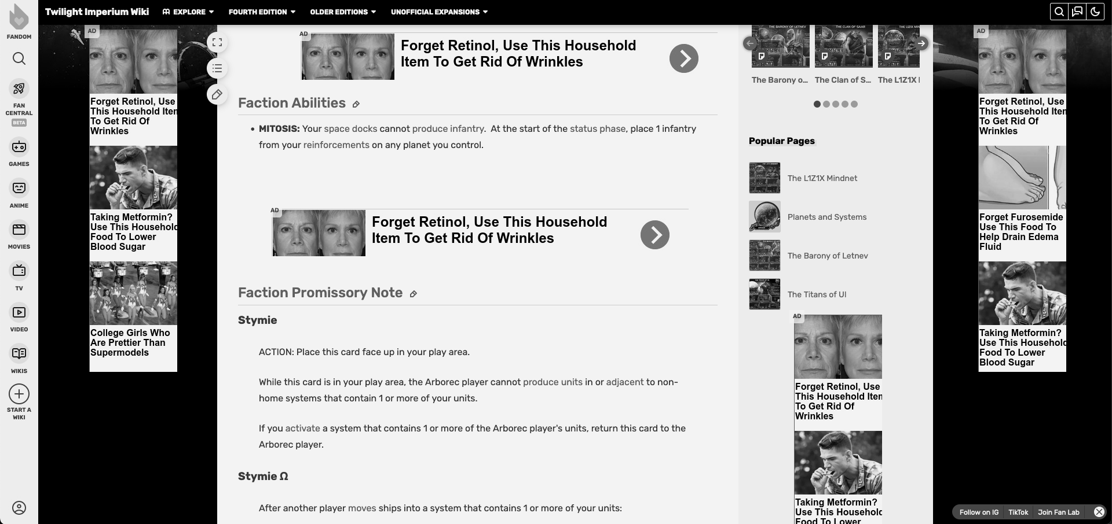
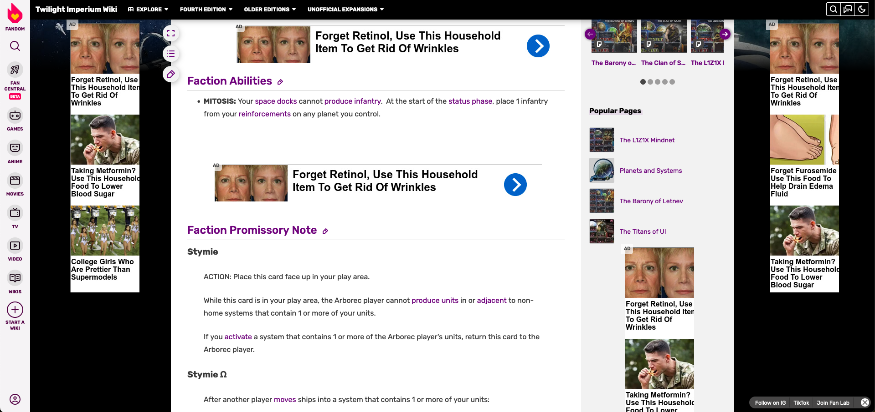
Notes:
But, making search incumbent on the data owner is much like the kind of web we have today. That’s why data owners need to find a way to pay for that compute, and that’s why we live in this ad-tech hell world. The very hell-world Solid hopes to move away from.

Slide 17
From “Triple Pattern Fragments: a Low-cost Knowledge Graph Interface for the Web”
“The processing of individual requests is potentially very expensive”
“the evaluation problem for SPARQL is PSPACE-complete”
“The majority of public SPARQL endpoints had an uptime of less than 95%”
Source: https://linkeddatafragments.org/publications/jws2016.pdf
Notes:
The people at Ughent agree, there’s real reasons we don’t want to popularize SPARQL endpoints on a Solid Pod. It puts too much stress on the data owner.

Slide 18
The Pod Should noT Be the Thing that Performs Search
Notes:
The Pod Should Not Be the thing that performs search

Slide 19
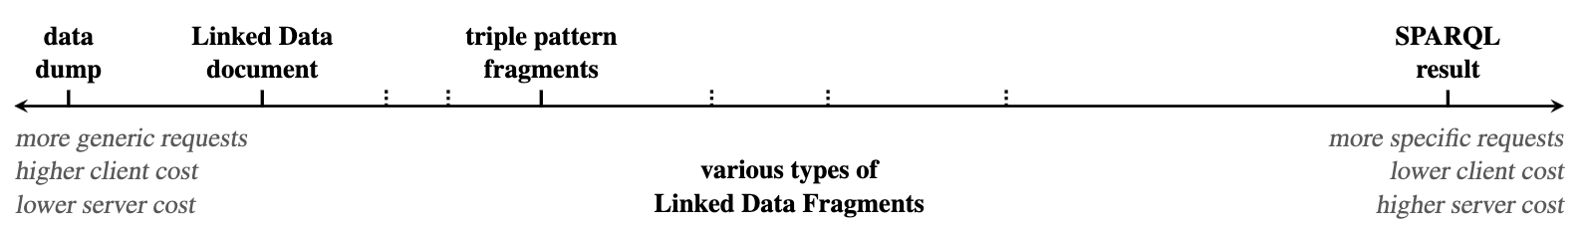
Source: https://linkeddatafragments.org/publications/jws2016.pdf
Notes:
In presented before paper, the researchers define a spectrum that’s a pretty good way of thinking about the tradeoffs in requests. On one end, you have a very fast technique but one that’s a higher cost on the Pod (SPARQL Queries) and on the right you have a technique that’s a low cost on the Pod, but is slow (a data dump)

Slide 20
Keep the average query as fast as possible (under 1000 milliseconds)
Offload search compute from from the data owner
Source: https://linkeddatafragments.org/publications/jws2016.pdf
Notes:
Two of our goals also seemingly map pretty cleanly onto this spectrum. And this suggests that it is not possible to achieve these two goals simultaneously. But, in the next section, I’ll talk about how we can do that.

Slide 21
Solution: searcher Centric
Search
Notes:
Now that we’ve talked about our criteria, let’s get to the solution: Searcher Centric Search

Slide 22
Private Index
Public Index
Notes:
And it comes in two parts: The Private Index for Private Data and the Public Index for Public Data

Slide 23

Private Index
Read Access Granted
My Private Index
Notification
<A><B><C>
<A><B><C>
Notes:
The Private Index is pretty simple,
Every user has a private index. At its simplest think of this as the user’s own personal triple store, though there are optimizations that can be done. This index is discoverable by the user’s profile, so in this example we see my private index
Now let’s say you’ve created or modified a resource and granted me read access. Whenever a resource is created, deleted or updated, a notification is sent to the private index of every agent that is explicitly granted read access.
From there, the private index can do what it wants, but in our simple triple store example, it will simply duplicate the data in this resource
Finally, when I make a request, all I need to do is a request to my own personal private data index.

Slide 24
Private Index
enable large-scale data search across Solid pods
SPARQL Endpoint
Pod A
My Private Index
Pod B
<A><B><C>
<A><B><C>
<X><Y><Z>
<X><Y><Z>
Notes:
Does this Enable Large Scale Data Search across Solid Pods?
Yes, the private index consists of data that’s coalited from every document the user has access to, across Solid Pods.

Slide 25
Private Index
respecting individuals’ data sovereignty, considering individuals’ different access rights and caching needs
Read Access Granted
Read Access Granted
<A><B><C>
<X><Y><Z>
My Private Index
<A><B><C>
<X><Y><Z>
Notes:
Does it respect individual’ data sovereignty condidering individual’ different access right and caching needs?
For access rights? Absolutely. Private data is only placed in the private index of agents that match the access control rules.
As for Caching needs… no, but we’ll discuss that later.

Slide 26


Private Index
Keep the average query as fast as possible (under 5000 milliseconds)
My Private Index
Notes:
Does the private index keep the average query as fast as possible?
Yes, under the hood, we can structure the private index like a traditional database, which means storing the index in memory.

Slide 27
Private Index
Request count and duration remains constant as Pod quantity increases
My Private Index
SPARQL Endpoint
<A><B><C>
<X><Y><Z>
Notes:
Does the query count and duration remain constant as Pod quantity increases
Yes, it doesn’t matter how many Pods share data with you, it just takes one request to query your private index

Slide 28
Private Index
Offload search compute from the data owner
My Private Index
Pod A
<A><B><C>
<A><B><C>
Notes:
Does this offload search compute from the data owner.
Yes, in the naïve triplestore case, a search doesn’t even touch the Data Owner’s Pod.

Slide 29
Public Index
Pod A
Centralized Public Index A
Crawl
<I><J><K>
<I><J><K>
<L><M><N>
Pod B
Centralized Public Index B
<L><M><N>
<I><J><K>
<L><M><N>
Notes:
Now let’s talk about public data. And again, we have a simple solution: we handle it the way search engines handle public data today:
We crawl it and index it.
However, this presents a problem. Crawling data isn’t event driven. Under a traditional crawler infrastructure, there is nothing to prompt an index to re-index data.

Slide 30
Public Index
Message Queue
Pod A
Centralized Public Index A
Notification
<I><J><K>
<I><J><K>
<L><M><N>
Pod B
Centralized Public Index B
Notification
<L><M><N>
<I><J><K>
<L><M><N>
Notes:
So, to solve this we can add a message queue. Whenever a document with public read access is updated, the Pod should send a notification to the public message queue.
But, then comes the question: who do we trust to host this message queue.

Slide 31
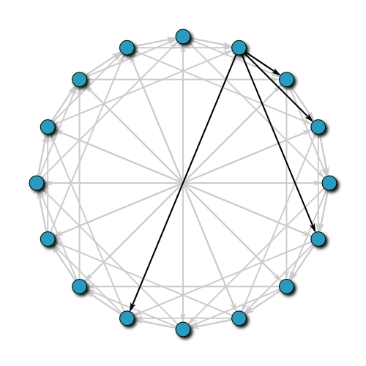
Public Index
Public Index
<I><J><K>
<L><M><N>
Centralized
(Private or Government Owned)
Collectively Owned
Notes:
One thing to note is that, while the DHT is collectively owned, we still need to have centralized indexes subscribing to the distributed hash table to enable fast search. Clients then just make a request to the centralized index of their choice to perform a search.

Slide 32
Public Index
enable large-scale data search across Solid pods
SPARQL Endpoint
Pod A
Centralized Public Index
Pod B
<I><J><K>
<I><J><K>
<L><M><N>
<L><M><N>
Notes:
Does this Enable Large Scale Data Search across Solid Pods?
Yes, the distributed hash table queue sends messages from across many Solid Pods, and the centralized indexes contain data from across Solid Pods.

Slide 33
Public Index
respecting individuals’ data sovereignty, considering individuals’ different access rights and caching needs
Centralized Public Index
Only Public Data
Only Public Data
Notes:
Does it respect individual’ data sovereignty considering individual’ different access right and caching needs?
For access rights? Yes. Only public data is shared with others.
As for Caching needs… no, but we’ll discuss that later, again.

Slide 34

Public Index
Keep the average query as fast as possible (under 5000 milliseconds)
Centralized Public Index
Notes:
Does the private index keep the average query as fast as possible?
Yes, the centralized indexes can use modern database optimization standards to make queries of public data as fast as possible. You’d probably need something akin to Google Bigtable under the hood.

Slide 35
Public Index
Request count and duration remains constant as Pod quantity increases
Centralized Public Index
SPARQL Endpoint
<I><J><K>
<I><J><K>
Notes:
Does the query count and duration remain constant as Pod quantity increases
Yes, it doesn’t matter how many Pods share public data, it only takes one request to query a centralized public index.

Slide 36
Public Index
Offload search compute from the data owner
Public Index
Pod A
<I><J><K>
<I><J><K>
Notes:
Does this offload search compute from the data owner.
Yes, the only data fetches need to be the initial crawl. From there, search won’t touch the data owner’s Pod.

Slide 37
Private Index
Client
Public Index
Notes:
And with that, a single client can search all data it has access to with just two requests: One to the private index, and one to the public index.

Slide 38
Source: https://linkeddatafragments.org/publications/jws2016.pdf
Notes:
Those keen-eyed among you might notice that Searcher Centric Search is actually here, on the data dump side of the equation.

Slide 39
Load the Index…
❎ During Search
✅ When data is updated
Notes:
We are simply loading the index when the data is updated instead of when the search is happening.

Slide 40
Drawbacks
Notes:
Cool, I’ve gone over some of the benefits to Searcher-Centric Search, but let’s talk about the drawbacks.

Slide 41

That’s a lot of duplication
Notes:
First all, replicating data to individual datastores is a lot of duplication. But, there is precedent for this. A scalable system we all know and love that works the same way. It’s called EMAIL

Slide 42
My Private Index
Pod A
<A>
<B>
<C>
<X>
<Y>
<Z>
<A><B><C>
Pod B
<X><Y><Z>
Notes:
But if that pithy answer isn’t enough for you. There are ways to optimize beyond simple data duplication.
For example, a private index could be a mapping between a NodeURL and all the the Pods that reference that NodeURL. That way you aren’t duplicating every triple, you’re just providing a map of where to query.

Slide 43
The search Index May Not work for real-Time Data
Notes:
Another problem is that the search index will not work for real time data.
Propagating updates to all private and public indexes may take time. That’s why for real-time data, it’s better to subscribe to the data directly rather than rely on search.

Slide 44
An index could get overloaded with Updates/Spam
Notes:
Another downside is that private indexes can get overloaded with updates/spam, but we have mitigated this problem in another scaled system. It’s called EMAIL.
But, seriously, mitigating spam is just a matter of doing the hard work and building spam filters.

Slide 45
Doesn’t Respect Caching Preferences
Cached Data
My Private Index
My Private Index
<A><B><C>
<X><Y><Z>
<I><J><K>
<L><M><N>
Notes:
And here’s the big downside one that I’ve alluded to: It doesn’t respect caching preferences. Obviously all data in these indices is cached data.
If a user labels data as “don’t cache,” it cannot be put on a public or private index.
But, if a user is labeling data as “do not cache” then they have to understand that means it’s going to be delivered slower.

Slide 46
Doesn’t Respect Caching Preferences
SPARQL
1 Pod
Notes:
If they really wanted to have uncached data that is quickly accessed, then they could fallback to the other solution: spend the compute power and put a SPARQL endpoint on their Pod.

Slide 47
Searcher Centric Search isn’t the Only Solution, but it should be the Primary solution
Notes:
That leads us to this: Searcher Centric Search isn’t the Only Solution, but because it satisfies all 5 use cases, it should be the Primary solution, with other solutions handling edge cases.

Slide 48
There’s No Way For you to Contact Me
jackson@o.team
Notes:
Our final drawback is that there’s no way to contact me. Oh wait, there is. It’s called EMAIL!

