Slide 1


Private Compute ON➛IN a Data Wallet
Terry Lee
Engineer, Dataswyft Group
Cambridge, UK
terry.lee@dataswyft.com
Dataswyft Network
v1.0

Slide 2
Some Definitions
Data Wallet
Digital tool for an individual to securely store, manage and control access personal information
Compute
Data processor that derives new information from existing data; and/or transforms proprietary data structures into standard data models.
Given height and weight attributes, the BMI is computed
Legacy JSON containing `first_name` and `last_name` transformed into FOAF
Private Compute
Computes done on Data Wallets
Must not leak, intentionally or otherwise
Must be privacy preserving. -> Anonymized.
The Primary Purpose of Compute on a Data Wallet is to create Data Assets

Slide 3
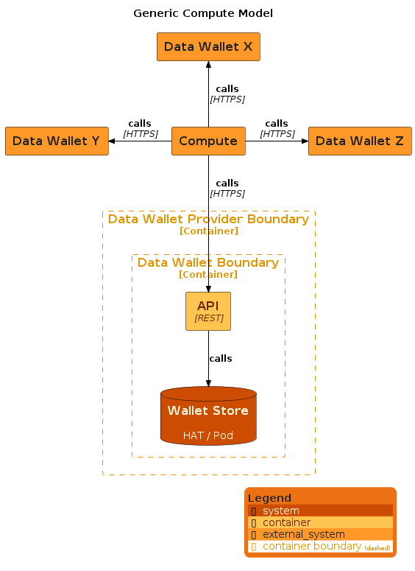
Compute ON Data Wallet
Generic Compute Model
Compute is an external entity. Resides outside the boundaries of the Data Wallet and the Provider
Characteristics
Compute can be in any programming language
Permissions handshaking needs to be handled by the Compute. It has to stored access credentials to every data wallet it connects to.
Able to easily aggregate data.
Most open form of computation. It can do anything with the data it collects. Create any asset
Data Wallet owner must trust the Compute
Discovery mechanism required for Compute to find the Data Wallets and vice-versa
High compute costs

Slide 4
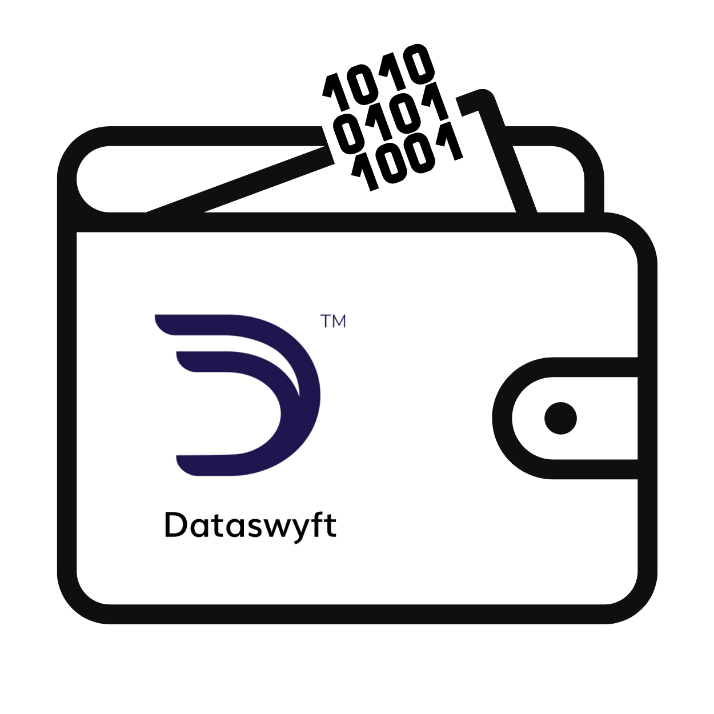
When creating data assets, where it is stored matters
Centralized Stores
Decentralized Stores
Decentralized Store (HAT)
Centralized store (e.g. Gov agency)
I consent
Centralized store (e.g. Gov agency)
Centralized System (e.g. Hospital)
Centralized store (e.g. Hospital)
I consent
Decentralized Store (HAT)
Centralized store
I consent
Centralized store
I “pull” my data
I “push” data
Decentralized Store (HAT)
Centralized store
I consent
Centralized store
Decentralized Store (HAT)
Centralized store
Centralized store
Decentralized Store (HAT)
On-ramp data connector
Off-ramp data connector
Credentials, insights (data assets) created here will create value slowly
Credentials, insights (data assets)created here will create value quickly

Slide 5
When moving data assets, where it is stored matters
Centralized Stores
Decentralized Stores
Dataswyft Wallet
Data assets
Rules
Schemes
Guard rails
Assurance levels
Decentralized Store (HAT)
Centralized store (e.g. Gov agency)
I consent
Centralized store (e.g. Gov agency)
Centralized System (e.g. Hospital)
Centralized store (e.g. Hospital)
I consent
Decentralized Store (HAT)
Centralized store
Centralized store
E.g. Name, Date of Birth, Address
I consent
I “pull” my data
I “push” data
E.g. Name, Date of Birth, Address
Decentralized Store (HAT)
Centralized store
I consent
Centralized store
Decentralized Store (HAT)
Centralized store
Centralized store
Decentralized Store (HAT)
On-ramp data connector
Off-ramp data connector
Consent fatigue, cybersecurity risk of multiple copies, slow setup for each connection (different APIs. different legal agreements)
One set of legal agreements, one set of APIs, fully scalable. New network entrants in minutes. Data moves safely, securely and quickly.

Slide 6
Dataswyft Wallet
Dataswyft Wallet
Has all the technical features of a Data Wallet
Is Decentralised
Is Personal
Has a legal layer giving data rights to the Data Wallet owner, enforcing and protecting said rights
Dataswyft Wallet
Data Assets
Schema Standards
Data Integrity and Assurance
Important Concepts
You only have rights to things that belongs to you
Data sitting in a Centralised system DOES NOT belong to you
When data is re-homed into your Dataswyft Wallet, the containing data is yours to share as you wish
This creates data movement efficiency in the entire data ecosystem
Dataswyft HAT
Compute
Secured Infrastructure
Legal Protocols and Governance
Compute
The optimal way to comply with such data rights requirements is to put the Compute as close to the Wallet as possible
Open-Sourced HAT

Slide 7
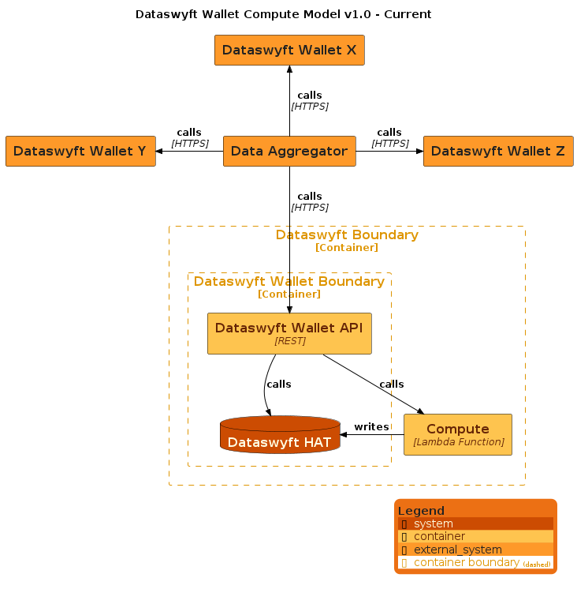
Compute ON➛IN Data Wallet
Dataswyft Wallet Compute Model v1.0
Compute is provided by the Data Wallet Provider.
Resides within the boundaries of the Provider but still outside that of the Data Wallet’s
Dataswyft uses AWS lambda functions to provide compute features to the Dataswyft Wallet
Characteristics
Limited programming language options
Natural permissions handshaking. Every Dataswyft Wallet has access to Compute.
Compute unable to aggregate data from other Wallets.
Compute can only write back to the Wallet.
Discovery mechanism NOT required
Intermediate compute-as-you-go costs

Slide 8
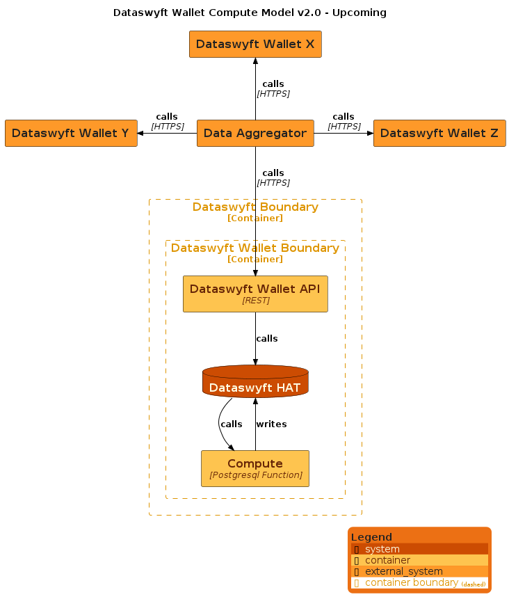
Compute IN Data Wallet
Dataswyft Wallet Compute Model v2.0
Compute makes use of the full power of the PostgreSql database
Resides totally within the boundaries of the Dataswyft Wallet
PL/Python, pg_ai, pg_vector, pg_llm
Characteristics
Limited programming language options
No permissions handshaking. Every Dataswyft Wallet is a Compute on its own.
Total coupling of data storage and compute
Compute unable to aggregate data from other Wallets.
Compute can only write back to the Wallet.
Discovery mechanism NOT required
Lowest cost

Slide 9
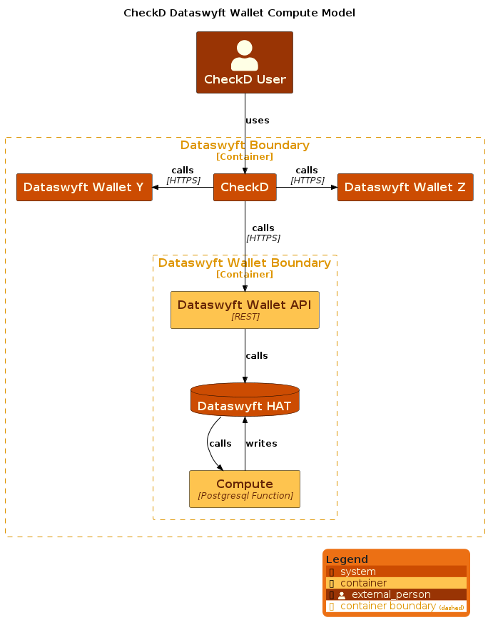
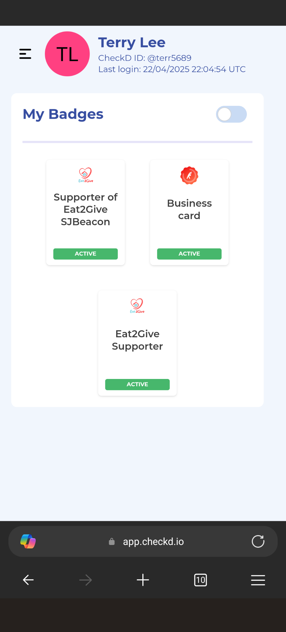
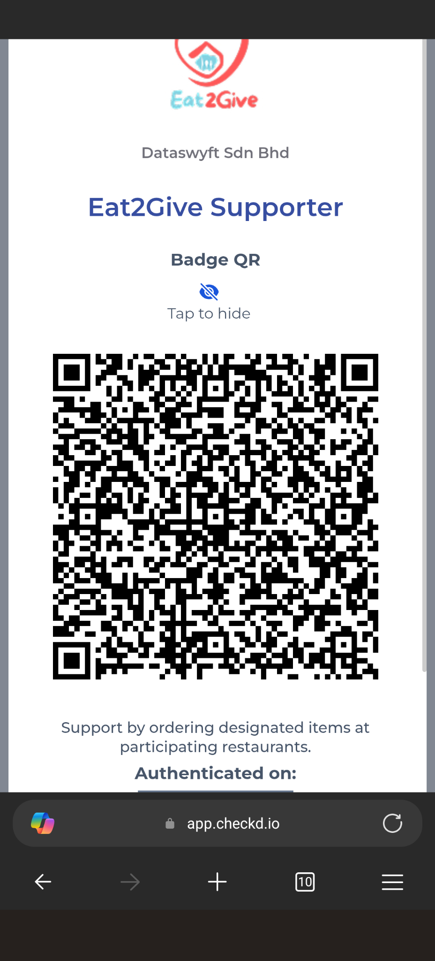
CheckD - Putting it altogether…
About CheckD
A Dataswyft Wallet that provides a phygital human-in-the-loop mechanism for wallet owners to share data assets through the use of Badges

Slide 10
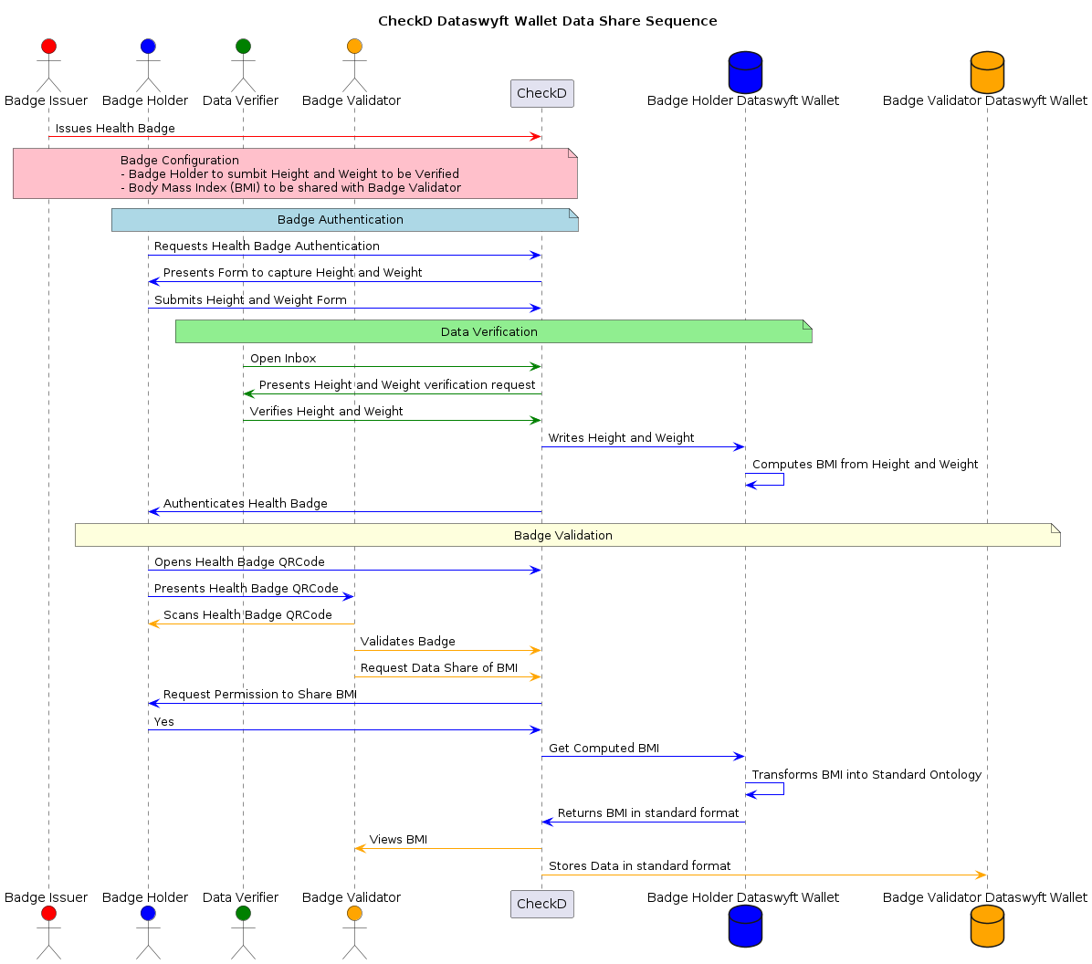
CheckD - Putting it altogether…
How it works…
Questions?

Slide 11
We are hiring!
If you are an expert in…
Dataswyft Wallet Engineer
Rust
Systems and Network are your forte
Senior Position
CheckD Engineer
Elixir Phoenix
Data is your second language
Senior Position
Send CV, Github and/or LinkedIn to your.future.with@dataswyft.com

