Slide 1
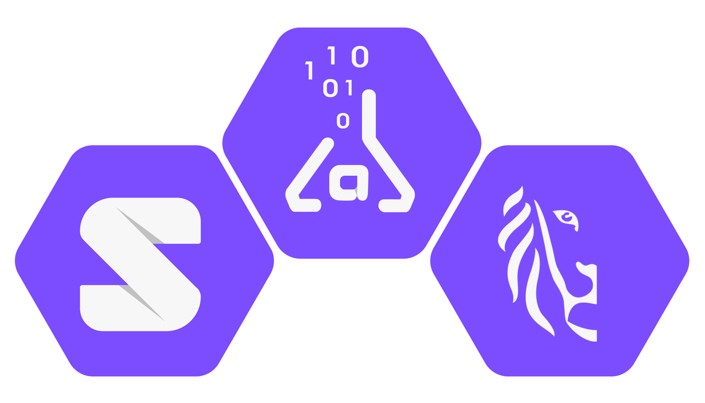
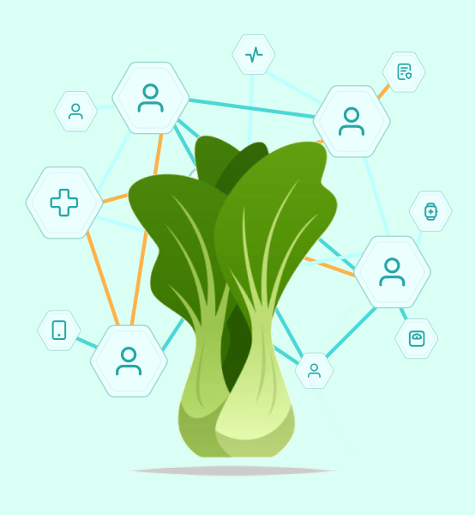
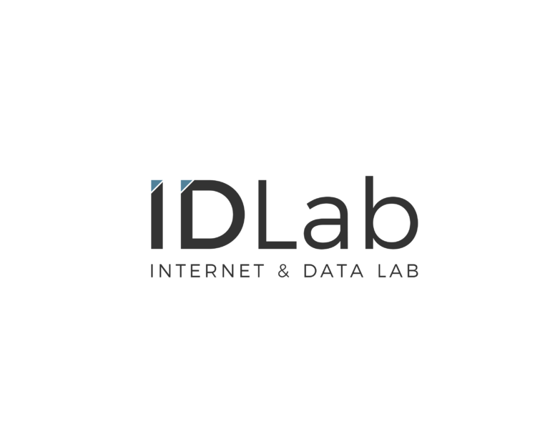



Paving the Way from Privacy to Trust
Beatriz Esteves, UGent – imec, BE
beatriz.esteves@ugent.be

Slide 2
p→purpose
lb→legal basis
Uses shoe size
to filter results
lb = consent
Uses shoe size
to filter results
lb = consent
Uses shoe size
to filter results
lb = consent
Uses shoe size
to filter results
lb = consent
I want to share
my shoe size
p = personalisation
I consent
I consent
I consent
I consent

Slide 3
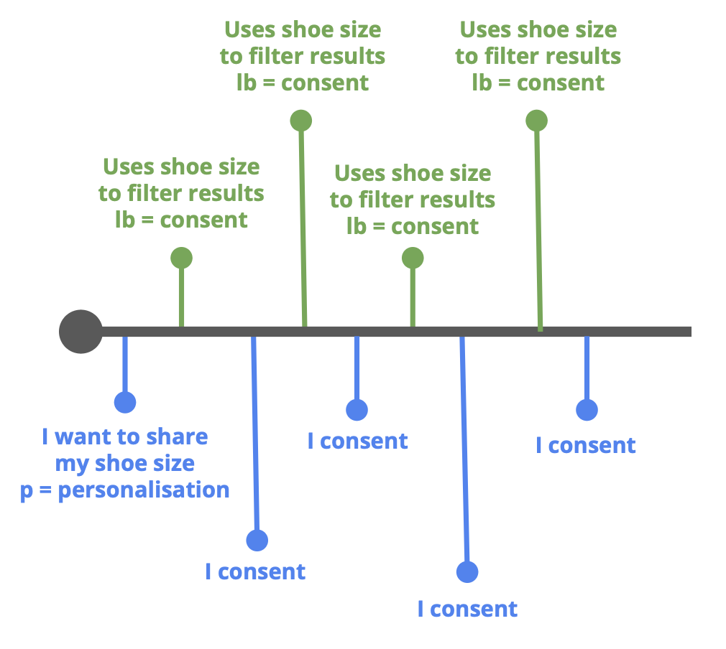
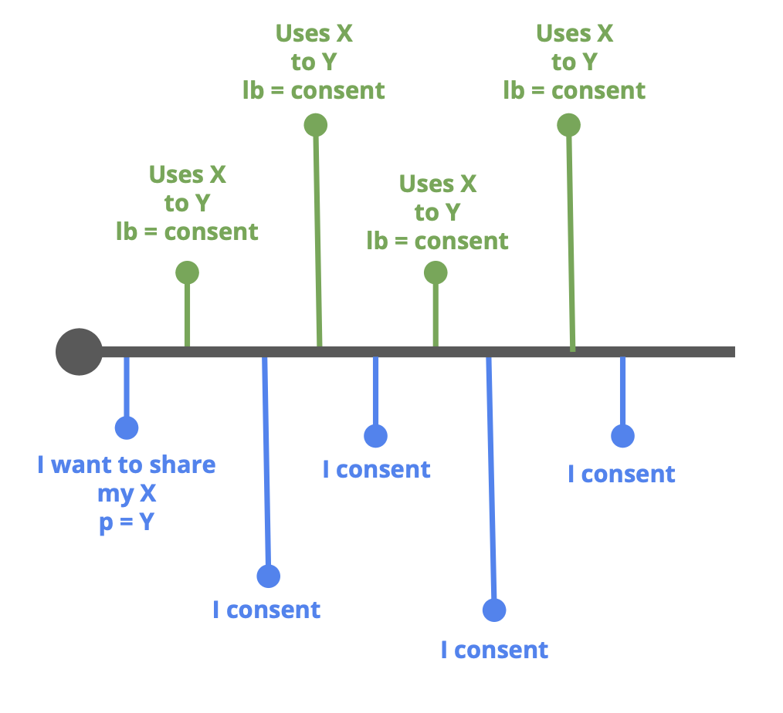

Slide 4
p→purpose
lb→legal basis
→automation
Ceases processing
Deliver shoes
lb = contract
I want to use
shoe size
p = marketing
lb = legitimate interest
Uses shoe size
to filter results
lb = legitimate interest
Contract handled
Send newsletter
I object
No marketing
I want to share
my shoe size
p = personalisation
I want to
purchase shoe X
Gets shoes delivered
Gets personalised
results
Provides access to address, payment details

Slide 5
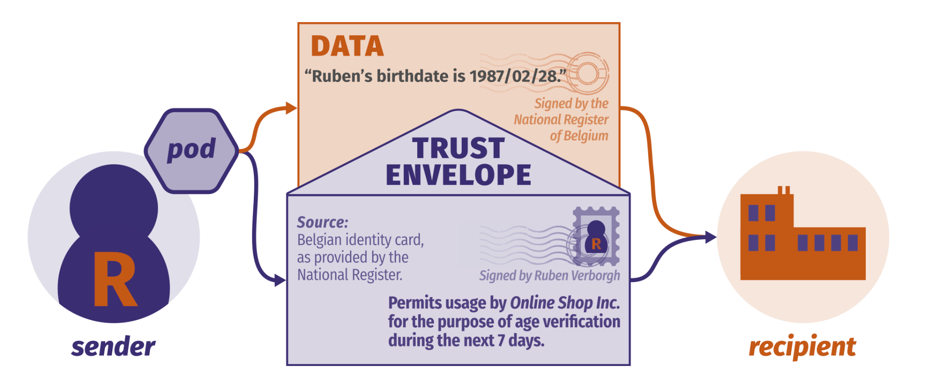

Trust envelopes as vehicles of history & destiny
Ruben Verborgh
https://ruben.verborgh.org

Slide 6
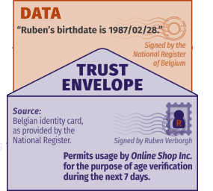
p→purpose
lb→legal basis
→automation
Ceases processing
Deliver shoes
lb = contract
I want to use
shoe size
p = marketing
lb = legitimate interest
Uses shoe size
to filter results
lb = legitimate interest
Contract handled
Send newsletter
I object
I want to share
my shoe size
p = personalisation
I want to
purchase shoe X
Gets shoes delivered
No marketing
Gets personalised
results
Provides access to address, payment details

Slide 7
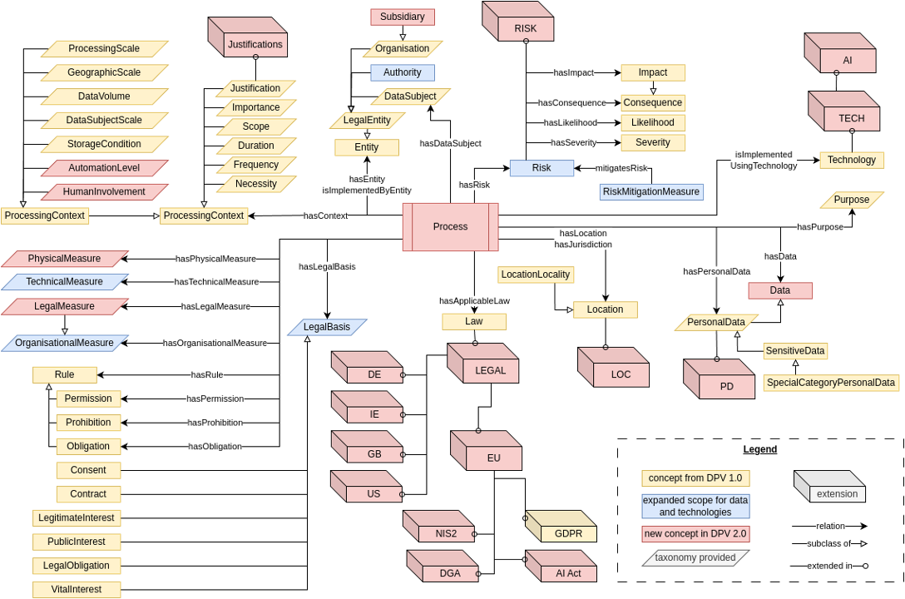
Data Privacy Vocabulary (DPV)
Developed by the W3C Data Privacy Vocabularies and Controls Community Group (DPVCG)
Defines a jurisdiction-agnostic ontology for expressing metadata about the processing of personal data
Provides hierarchical taxonomies, from abstract to more specific concepts, to instantiate specific concepts in practical use-cases
Has law-specific extensions
https://w3id.org/dpv

Slide 8

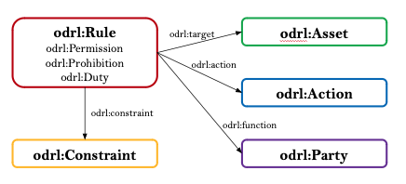




Other semantic standards
https://www.w3.org/TR/vocab-dcat-3/
http://www.w3.org/TR/prov-o/
W3C Open Digital Rights Language (ODRL)
https://www.w3.org/TR/odrl-model/
http://purl.org/dc/terms/

Slide 9
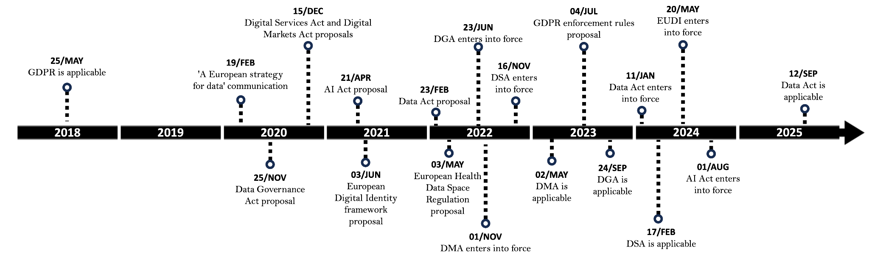
Advancing legal compliance in the Solid ecosystem with DPV
Session: From concept to reality: becoming a pod provider (Friday 25 April, 14h - 17h; room BW0.19)

Slide 10

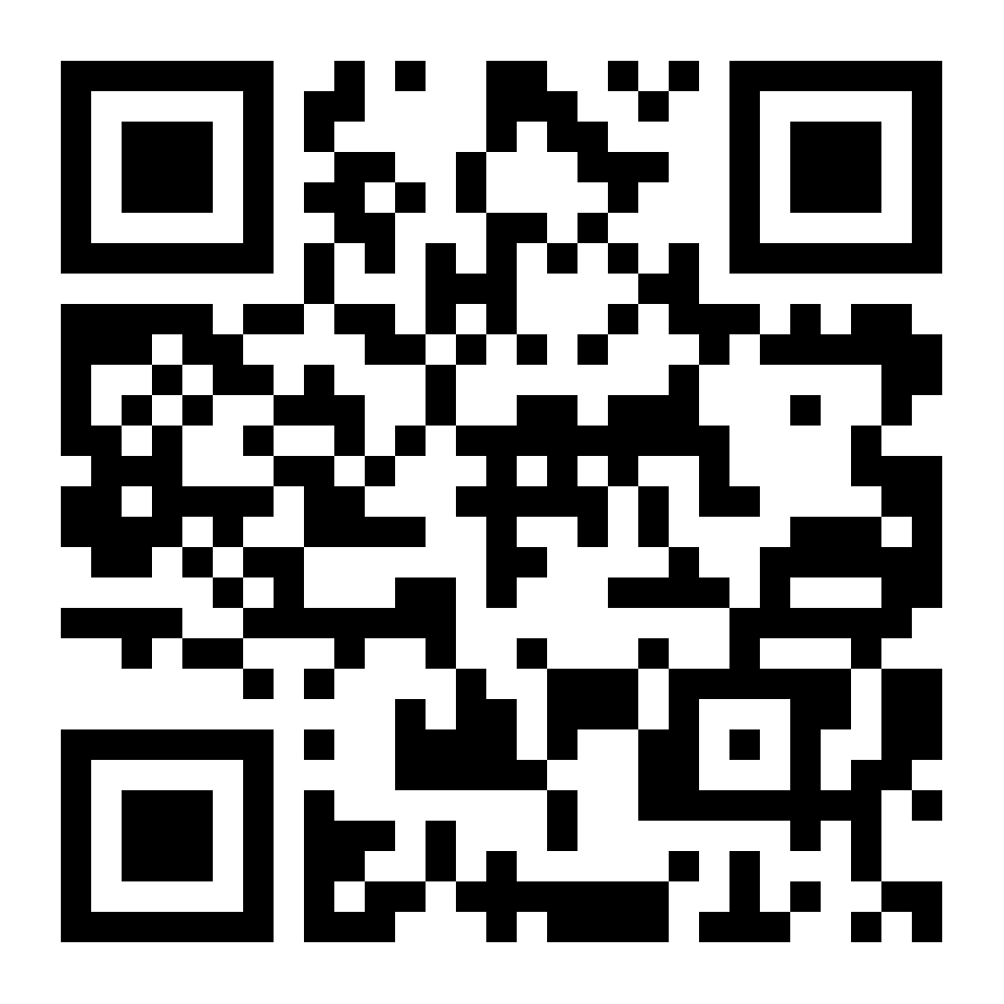
https://w3id.org/nxdg/2025

Slide 11
Paving the Way from Privacy to Trust
Beatriz Esteves, UGent – imec, BE
beatriz.esteves@ugent.be

