Slide 1


ESPRESSO: Privacy-Preserving Keyword Search on Decentralized Data with Differential Visibility Constraints
Mohamed Ragab
Electronics and Computer Science, Southampton University, UK​

Slide 2
Introduction
Decentralized data cooperatives require privacy-aware search.
Problem:
  We need to all search parties with granted access to the data, while others should see nothing.
Challenges:
  Differential access control complicates search efficiency.
  Centralized indexing violates privacy/autonomy.

Slide 3
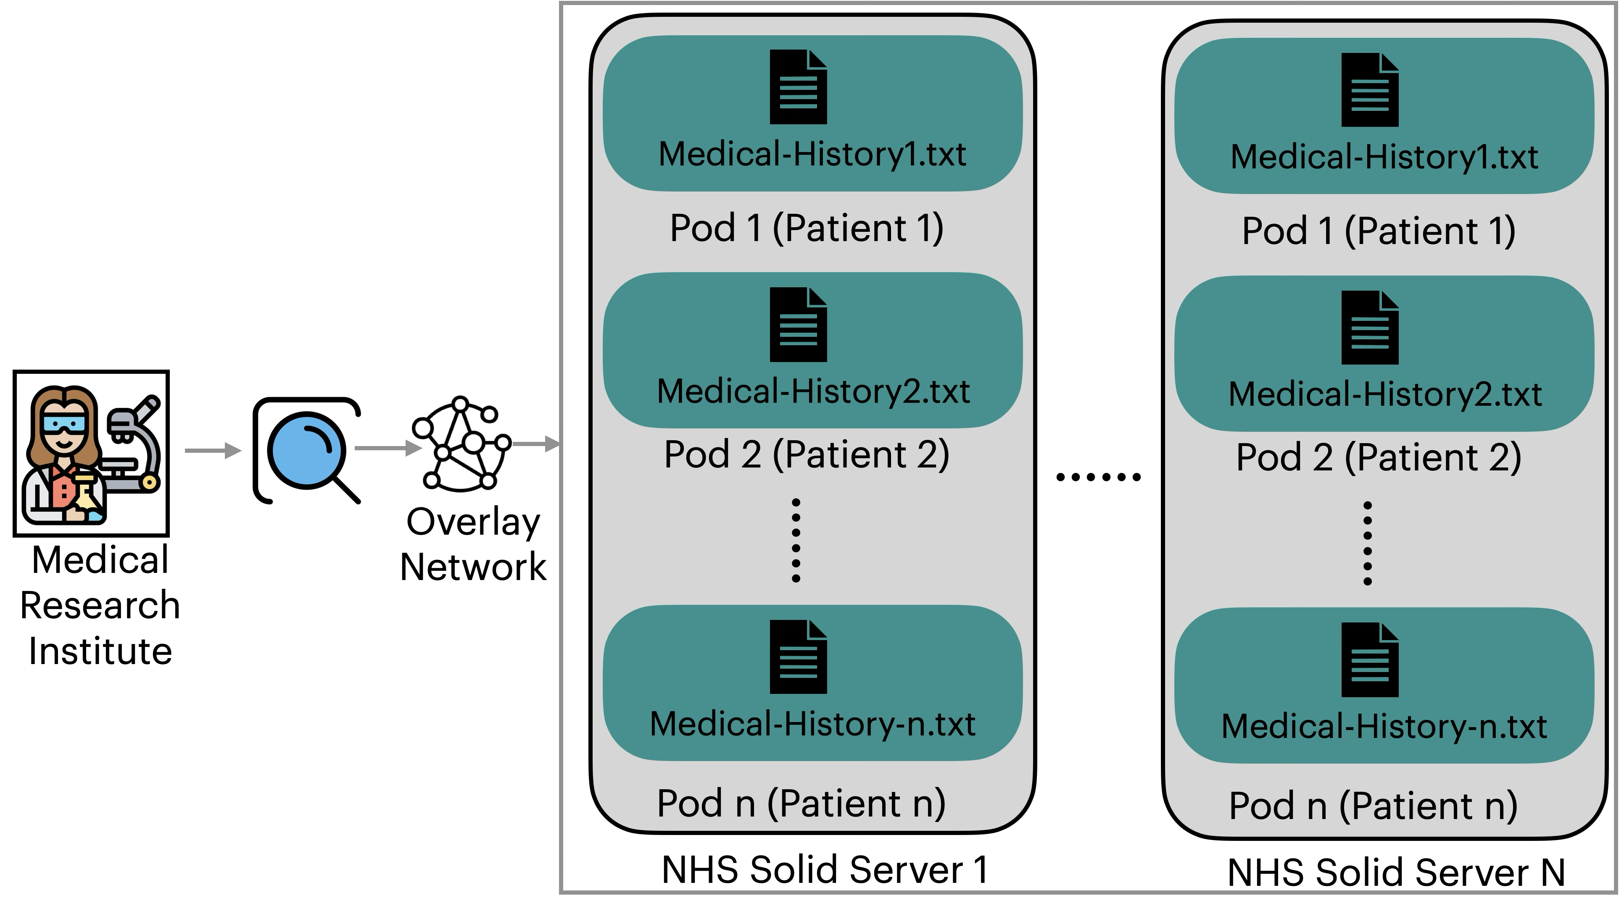
Motivating Scenario
Notes:
"The Solution: Alice searches for the mentions of diabetes using MRIWebID on the specified servers, and hence obtain a list of people who have diabetes mentioned in their medical history and whom they can contact. Because the people who agree to be in trials made their contact information accessible to MRIWebID, and the search results are personally identifiable, Alice can then contact the potential candidates directly and invite them to participate in the trial."
"Additional considerations: If there is a standardized format for medical data (like Fast Health Interoperability Resources (FHIR) data integration schema, see [8, 16]), instead of searching for the keyword, a structured query can be formulated that is tailored to the format."
“The scope is limited to specific servers (the NHS servers). This is organizational (the search party uses MRIWebID which belongs to an organization), keyword search.”
search party: organization (MRI)
search type: keyword
server scope: NHS servers only
pod owners: those already identified on the NHS servers
acls: {MRIWebID}
origins: not specified
filetypes: patient records are held in several different coding systems, plus various kinds of unstructured/free text data
other, eg location: NHS datacentres

Slide 4
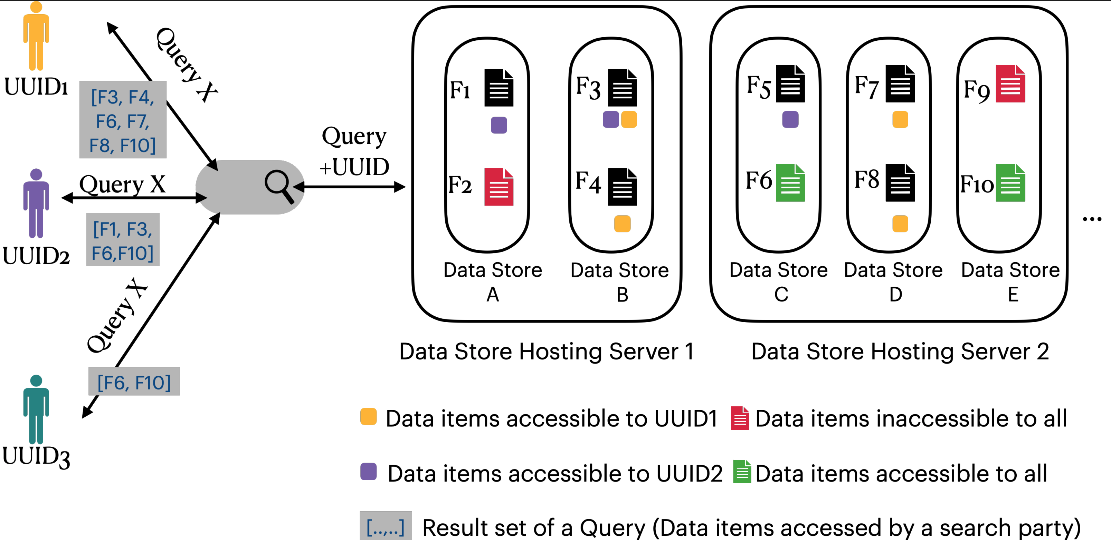
As a result, search parties might receive different results for the same query based on their granted access rights.

Slide 5
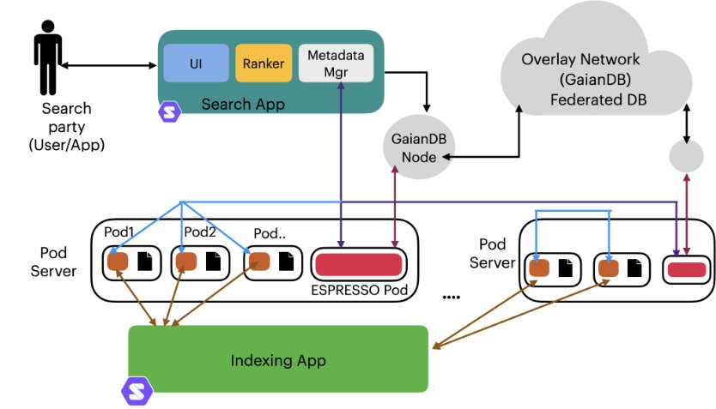

ESPRESSO Overview
Core Features:
  Privacy-preserving decentralized indexing (User-specific indexes).
  Metadata-driven source selection (server/pod filtering).
  Decentralized ranking (BM25 + access constraints).
https://espressoproject.org/

Slide 6
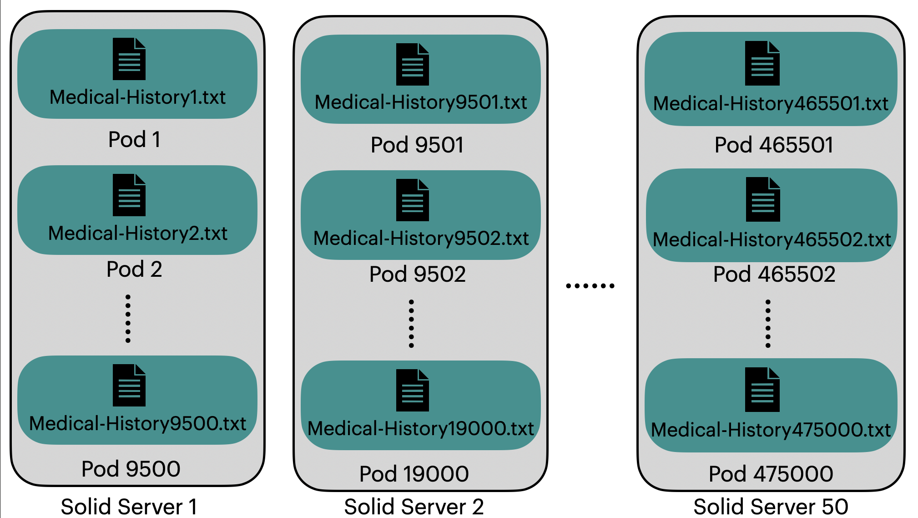
Demo Setup
Testbed:
  50 Solid servers
  9,500 pods, representing patients.
  Each Pod includes a single unified Partient Medical History.
  Access control: Search parties with 5%, 10%, 25%, 50%, 100% visibility access.

Slide 7
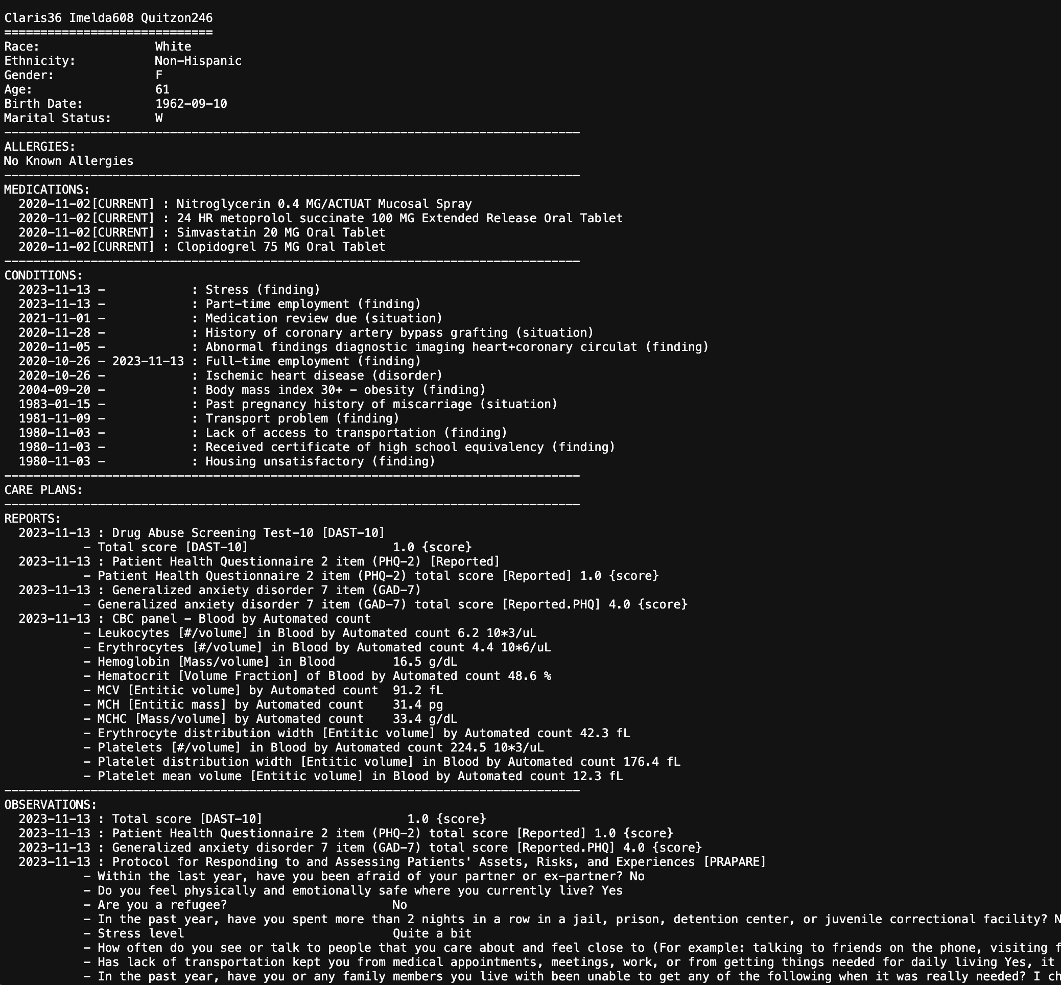
Dataset
Dataset
  Medical Histories are generated using Synthea data generator.
  https://synthea.mitre.org/
Example of Medical History.

Slide 8
Now, let's see ESPRESSO in action!

Slide 9
Scenario A:
Search with Varying Access Levels
Search from a search party with Full access (100%).
Less data visibility scopes 50%, 25%, 10% and 5%.
Search with an unauthorized or No data access (0%).

