Slide 1
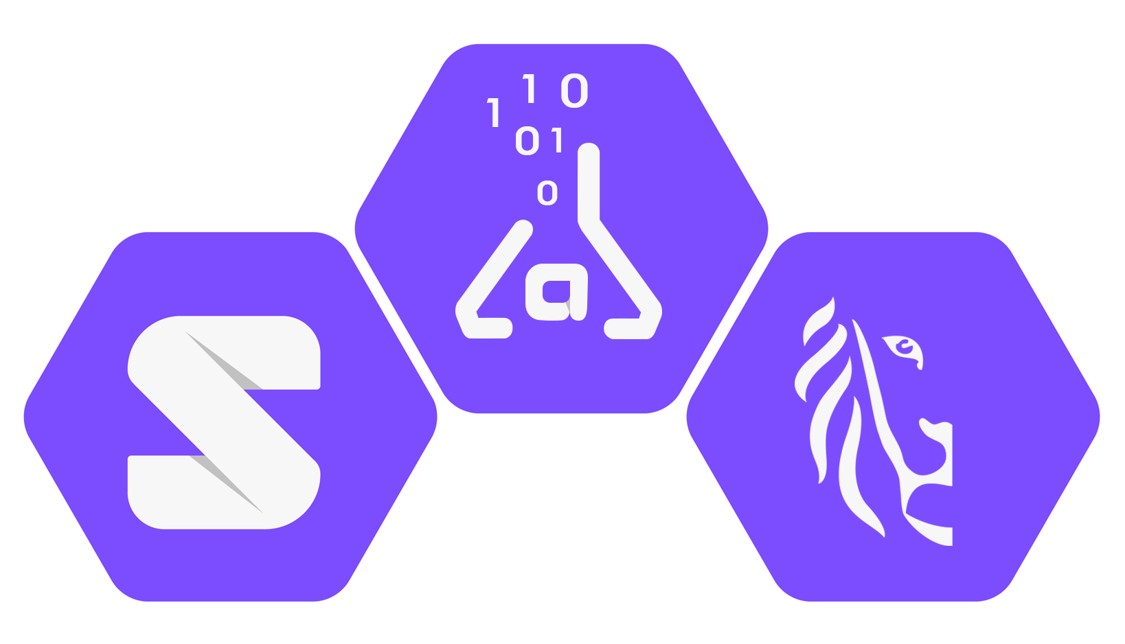
7/10
Citizens
don’t trust companies
with their
personal data
Source:
SolidLab Digimeter

Slide 2
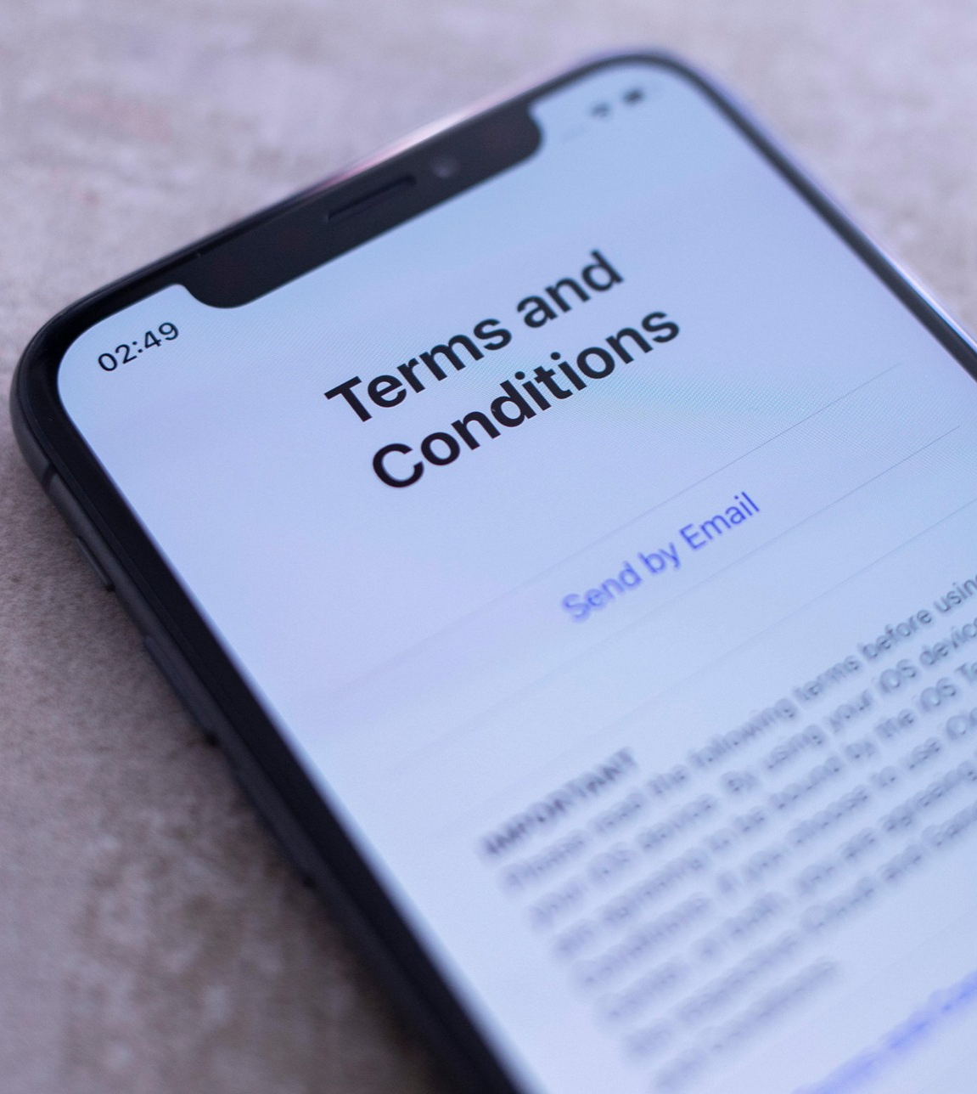
Why SolidLab Flanders?
Interoperable data sharing ecosystems
Legal frameworks
As a first step
Notes:
Image source: https://www.ft.com/content/4a647843-84ce-458b-8494-782166705f07

Slide 3
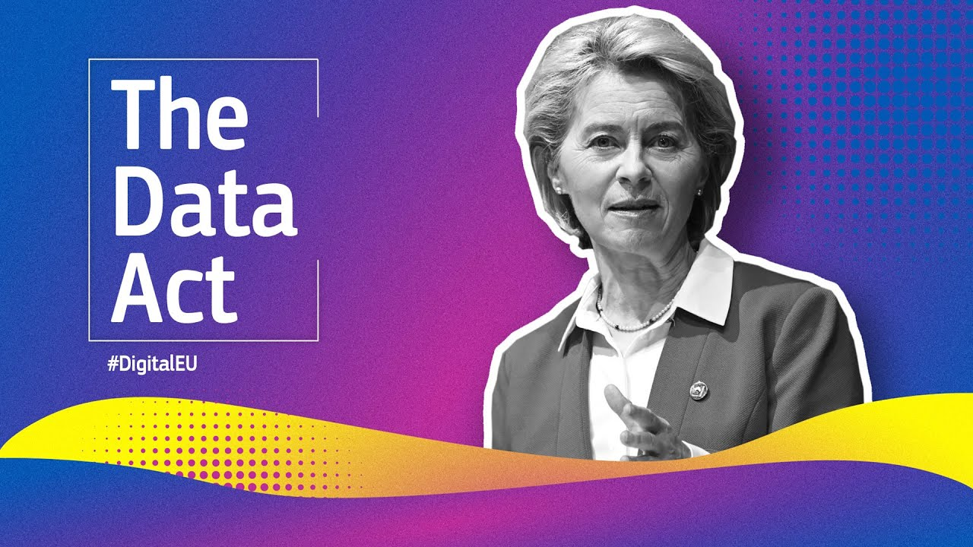
Notes:
Raf

