Slide 1
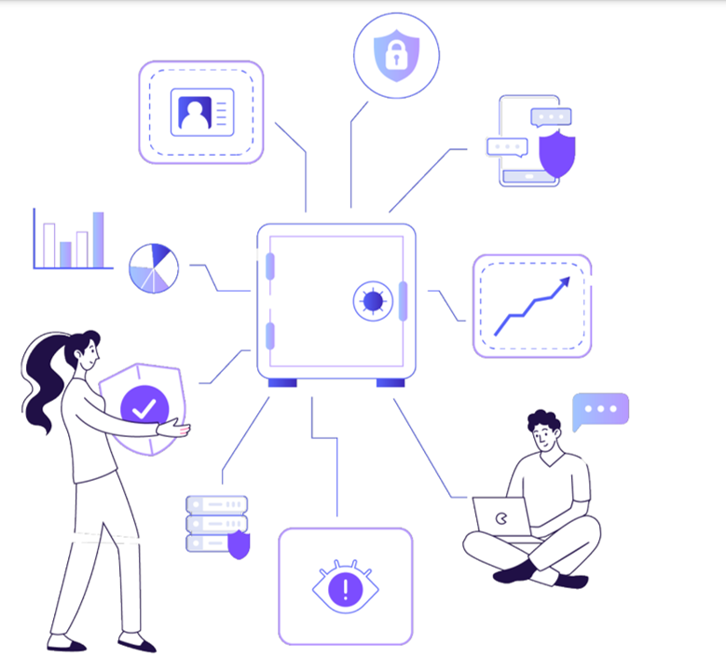


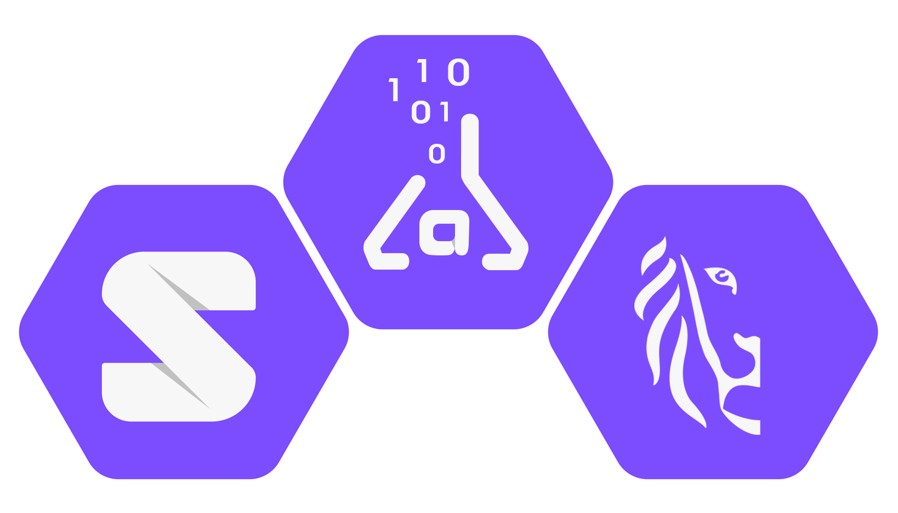
Why SolidLab Flanders?
Flemish data utility company
SolidLab Flanders
Interoperable data sharing ecosystems
Notes:
Image source: imec

Slide 2

Why SolidLab Flanders?
Interoperable data sharing ecosystems
“We are experiencing a data paradox.”
Prof. Media, Technology & Innovation Lieven Demarez
Notes:
Image source: imec

