Slide 1


From data vault to data gateway
Data vault
Focus on storage
Focus on single source of truth
Focus on privacy
Focus on explainability
Focus on data volume
Data gateway
Focus on access management
Focus on authentic sources
Focus on personalized services
Focus on convenience
Focus on value creation

Slide 2
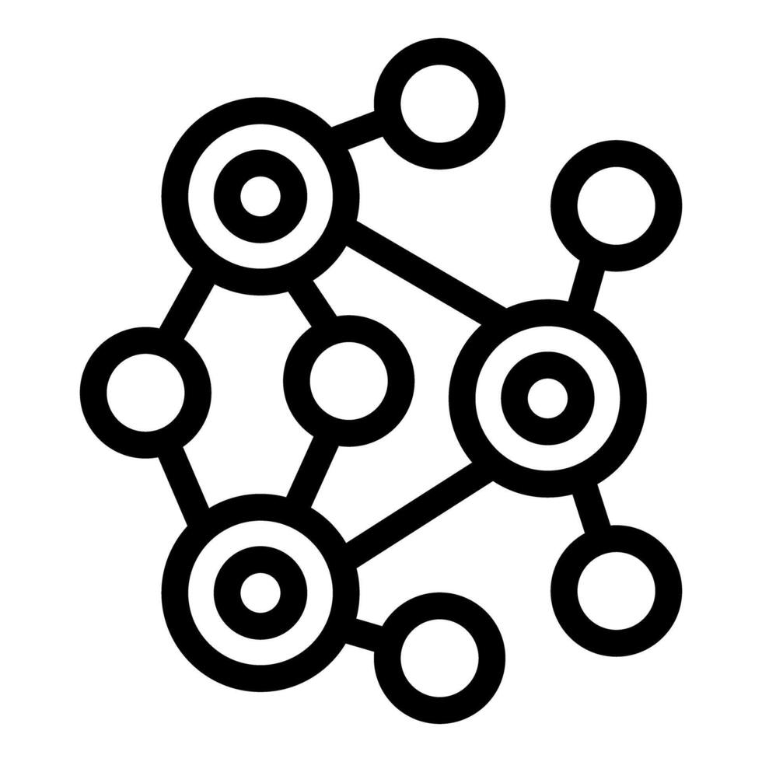

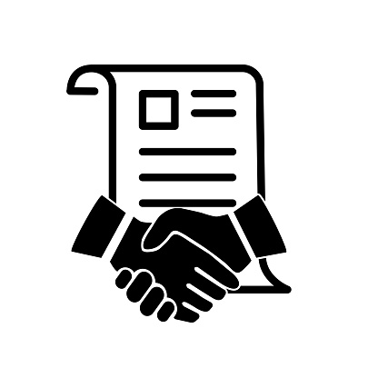
From data gateway to data space
Data broker
Clearing
house
Usage policies
Usage policies
Data space
Data provider
Data consumer
App
Store
Vocabulary
Identity Provider

Slide 3
From data gateway to data space
Data gateway
Focus on access management
Focus on GDPR consent
Focus on data sharing
Focus on raw data
Data space
Focus on usage policies
Focus on other legal patterns
Focus on data collaboration
Focus on data insights

Slide 4
convenience versus decentralization
Role of data intermediaries

Slide 5
Contact:
Esther De Loof: esther.deloof@imec.be
solidlab.be

