Slide 1
Market reflections on decentralisation
Esther De Loof – Operational Director SolidLad

Slide 2
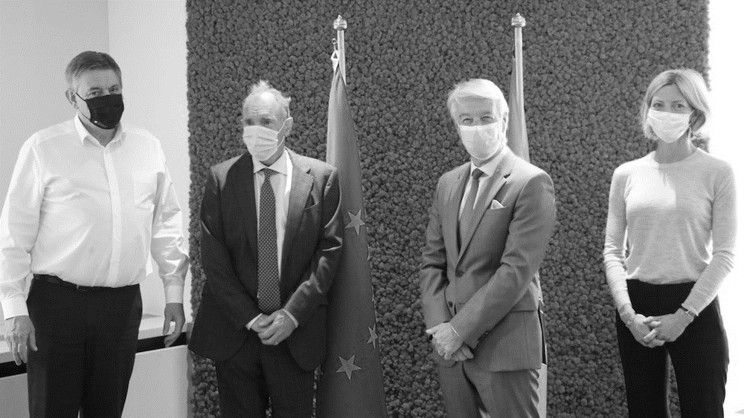
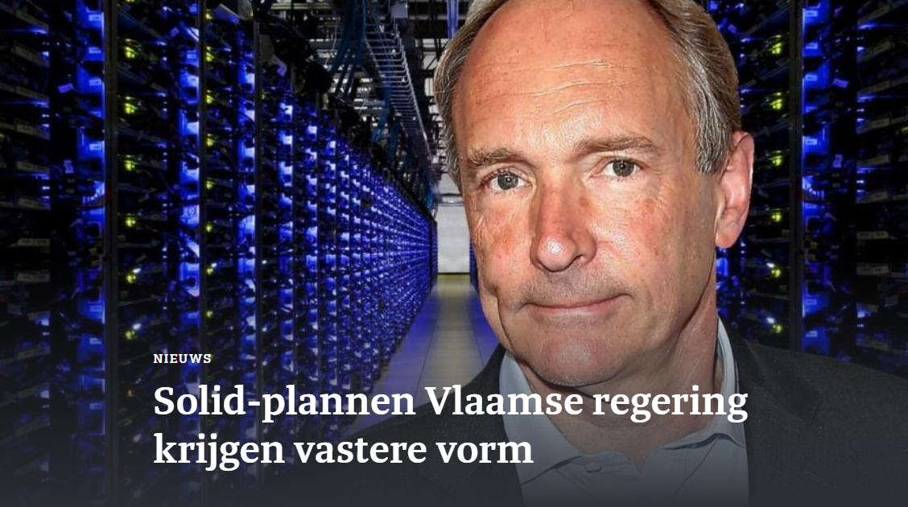
Why SolidLab Flanders?
Interoperable data sharing ecosystems
Notes:
Image source: imec

Slide 3
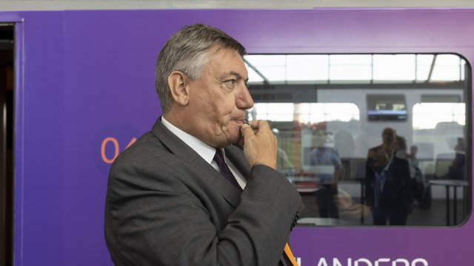
Why SolidLab Flanders?
Interoperable data sharing ecosystems
Inventor of the web
Sir Tim Berners-Lee
Flemish minister-president
Jan Jambon
Notes:
Image source: imec

