Slide 1



ESPRESSO:
Privacy-Preserving IR
for
Decentralized Data Cooperatives
Helen Oliver, Birkbeck, University of London
Mohammad Bahrani, University of Southampton
Mohamed Ragab, University of Southampton

Slide 2
What is ESPRESSO, again?
it’s the first search engine for decentralized data cooperatives that have differential access control
like, for example, Solid
but not only Solid! we are also implementing it for Dataswyft
Dataswyft, the forerunners of Solid, are ESPRESSO project partners

Slide 3
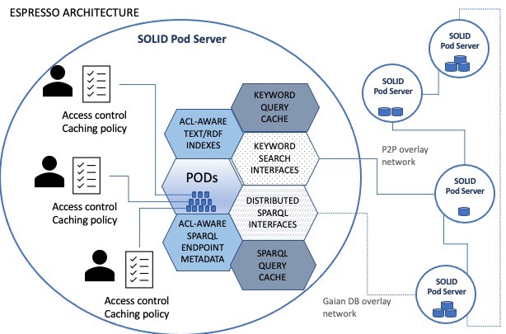

Slide 4
ESPRESSO search incorporates differential access control
UUID-specific indexing + layered indexing architecture
pod index: {keyword: {UUID: {frequency: {[list of filenames]}}}}
server index: {keyword: {UUID: {frequency: {[list of pods]}}}}
network index: {keyword: {UUID: {frequency: {[list of servers]}}}}
the mother of invention: info about a pod must stay in the pod

Slide 5
Conservativity Property of ESPRESSO meta-information data structures during Search
Informally, we do not maintain any data in the ESPRESSO meta-information data structures on S that could not be computed by submitting a set of search queries to S and running some computable function on the set of results.
Example: for a simple server-level index, the function f computes a set of triples
{(w₁,q_{1,}n₁), (w₂,q_{2,}n₂), …, (w_{r},q_{r,}n_{r})}
such that n_{i}= |(Result(w_{i},q_{i},S)|

Slide 6
And Now, A Quick Demo

Slide 7
IR in ESPRESSO
The basic task of IR is to guide the search party to relevant existing resources.
Our fundamental research question was: how do we do this basic IR task in this environment?
Differential access control complicates the question:
How do we find relevant resources in response to a search query
that the search party has access to
without returning any results the search party doesn’t have access to?
Harman, D. (2011) Information retrieval evaluation. Morgan & Claypool Publishers.

Slide 8
IR in ESPRESSO
A few words on our ongoing experiments

Slide 9
IR in ESPRESSO
If ESPRESSO’s approach seems basic, it’s meant to be
Traditional IR is:
transparent
human-in-the-loop
supports sovereignty
Hersh, W. (2024) ‘Search still matters: information retrieval in the era of generative AI’, Journal of the American Medical Informatics Association, 31(9), pp. 2159–2161. Available at: https://doi.org/10.1093/jamia/ocae014.

Slide 10


